Slide 1
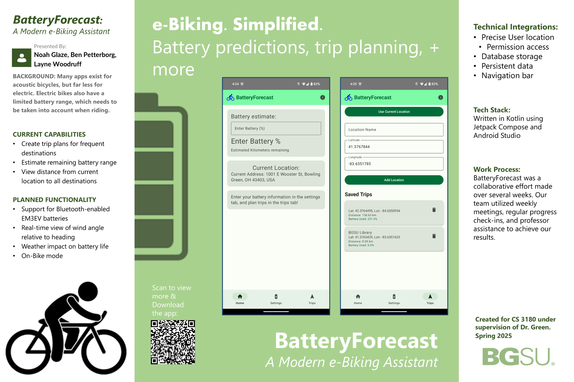

Slide 2
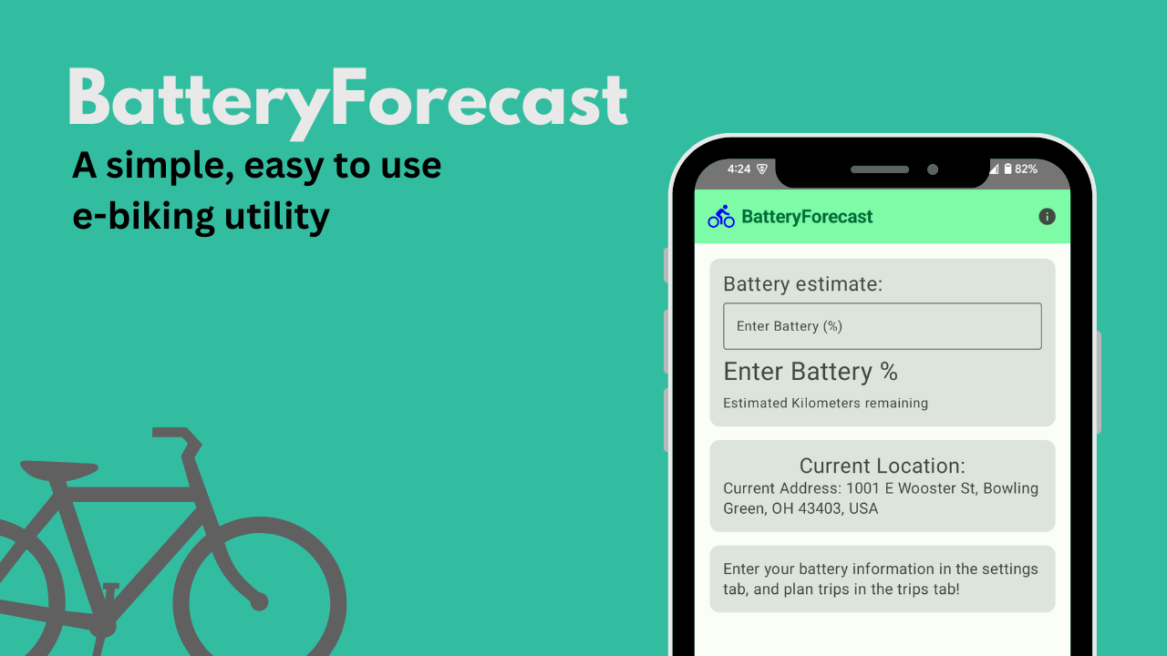
BatteryForecast
Noah Glaze, Layne Woodruff, & Ben Petterborg

Slide 3
Motivation
Many existing trip planning apps targeted at bike commuters fail to respect user's privacy
  Plus, they often have ads or unneeded features
Two-thirds of our group have e-bikes and saw a need improved battery and weather tracking
  Anxiety of running out of battery mid-ride can hinder a e-biking experience
Weather conditions in Northwest Ohio are especially unpredictable
[TBD] In existing weather apps, hourly wind conditions are buried in menus
Notes:
Wind is one of the most important factors on battery usage when riding. Temperature can have an effect, but it is far less significant.
Northwest Ohio is an especially windy place, especially on farm roads.
Ben hates driving more than he hates bad weather

Slide 4
Similar Apps
eBike Flow
  Feature rich, but restricted to certain bike brands + in app purchases
Komoot
  Detailed maps, but not e-bike specific, and users must pay per map/region

Slide 5

Basic ideas Guiding our app
Existing biking apps don't track e-bike usage and are typically only for route charting. (Maps, Ride with GPS etc)
Battery integration lets users figure out how much input they need to maintain a charge, or save charge for the hardest parts of their commutes.
We can track battery capacity, bike+rider efficiency, weather, and distance to destinations.

Slide 6

Ideas - International
The app would be usable between different regions.
Biking infrastructure may change but calculations will be consistent.
New locations can be stored for a trip abroad!
App shouldn’t be dependent on geo-restricted features
Notes:
Interface may need tweaks based on local culture and infrastructure

Slide 7
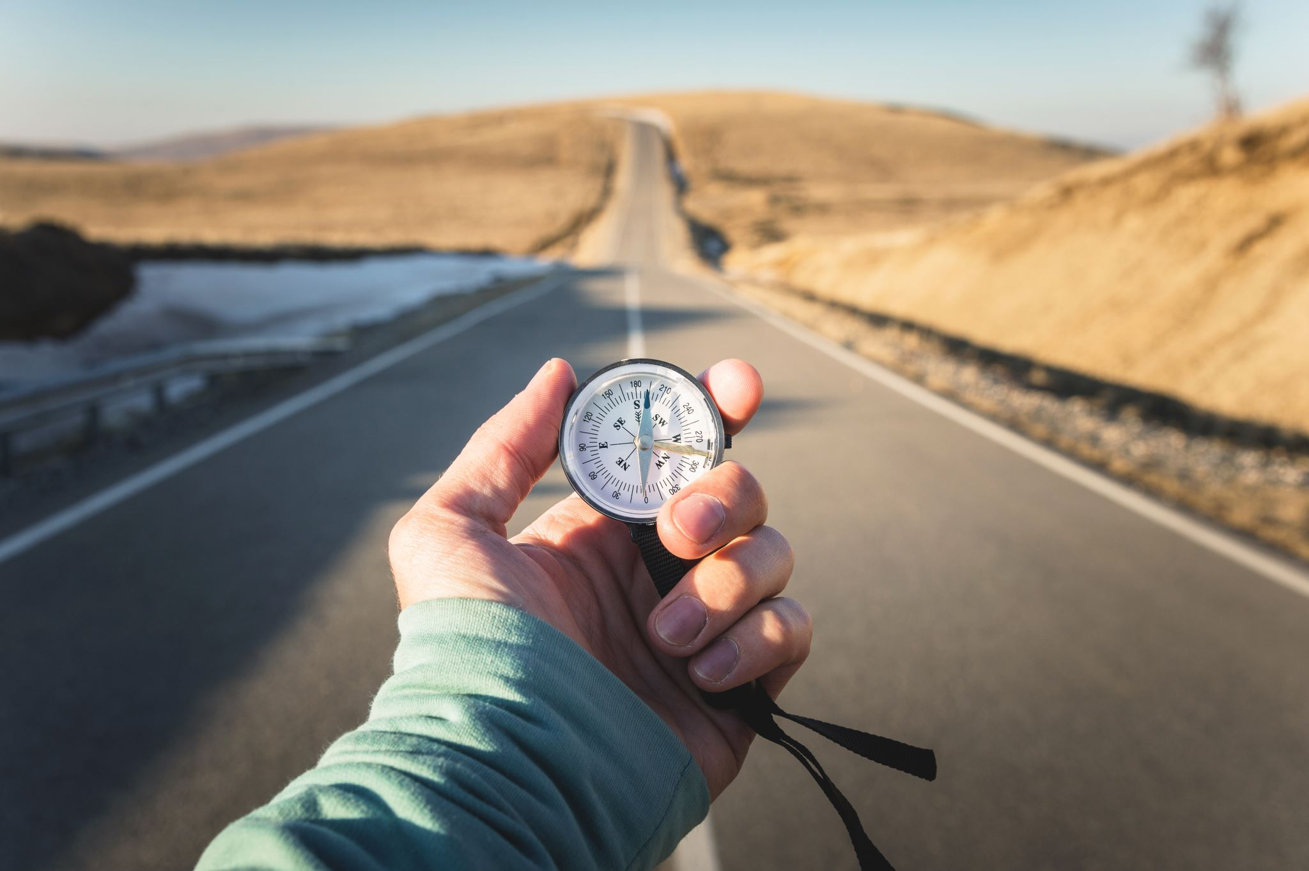
Trips!
A Trips page holds user-specified locations
Biker’s current location is easy to add
Users can give locations custom names
Commuters can instantaneously view the current distance and battery percentage needed to ride to the locations they enter.​
Notes:
If no battery information is given, the trip is still shown but without the battery calculation

Slide 8
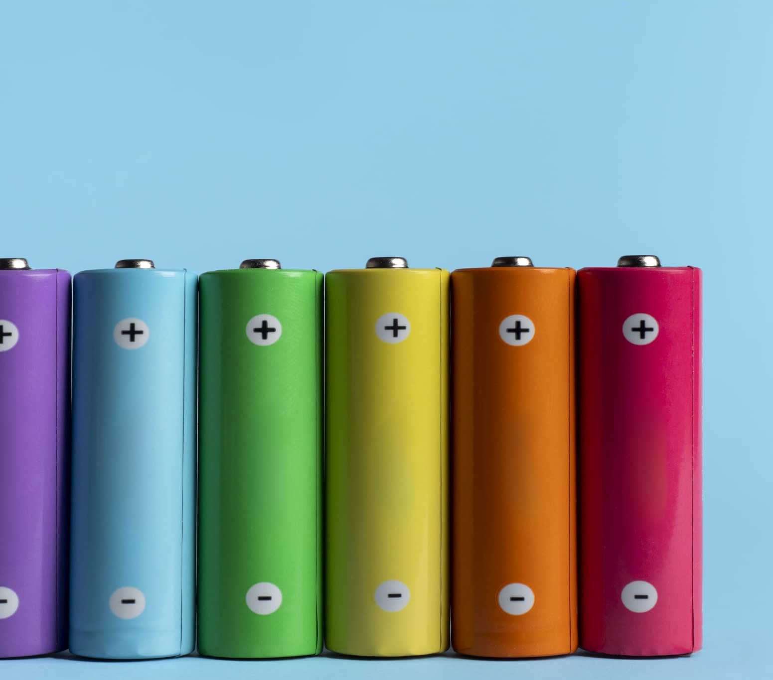
Battery?
Currently, range is estimated with the battery's voltage, amp-hour rating, and typical maximum range.
The user can calculate their remaining range on the home screen
  The calculation will improve once weather support is added
This calculation is used on the Trips page.
Planned future support for bluetooth EM3EV battery telemetry to be used in estimation calculation
Notes:
Currently, users supply battery parameters to use for range estimation
Though it was out of scope in this initial milestone, in the future, we hope to implement connectivity with bluetooth-enabled EM3EV batteries, which can provide pack-by-pack cell amp-hours, as well as pack and ambient temperatures.

Slide 9
PLANNED FUTURE ADDITIONS
Ability to string together locations into a single round-trip (or 1-way) route.
BMS bluetooth connectivity
Multiple savable battery and bicycle profiles.
Detailed weather information
Locations by address search
Pin-drop location picker
On-handlebars mode, detected with accelerometer
OsmAnd plugin
Notes:
Trip chaining, where multiple destinations can be added as stops along a route
Battery management system connectivity via bluetooth, allows us access to pack and ambient temp, as well as current charge level.
Detailed hour-by-hour weather information – this did not make it to the end of this milestone, but is planned for the next.
On-handlebars mode, which we will detect with vibrations transmitted through the handlebar mount. This is in the interest of user safety and minimizing potential liabilities.
OsmAnd is a mapping tool. We hope to integrate range estimation as a gauge in the app.
Somewhat popular in the cycling community for it's improved cycling infrastructure mapping

Slide 10
Challenges- Into learning
Gradle is a pain… enough said
Had to rewrite almost the entire app
  Resulted in a better product, so it was worth it
Issues with setting up the DAO
Many Trips Page bugs (squashed!)
Git

Slide 11
Questions?
We’d love to hear your feedback!
Thanks for watching our presentation!

